Slide 1
The Marketing Plan
Chapter 2

Slide 2
Marketing Planning
SWOT Analysis
  An assessment of a company’s strengths, weaknesses, opportunities and threats
  An analysis list of everything that can foster their business’s success and what could make it fail

Slide 3
Internal SWOT Analysis
Company analysis
  What a company does well and where its weaknesses are (page 27)
    Staff related questions
    Financial Questions
    Production Capability Questions
    Marketing Mix
Customer analysis
  Who? How do they differ? What, when, where and how much do they buy? Etc
Competitive Position

Slide 4
External SWOT Analysis
Competition
Environmental Scan
Political
Economic
Socio-Cultural
  Based on customers and potential customers
    Lifestyles, attitudes, opinions, etc
Technological

Slide 5
Internal SWOT Analysis
Strengths
Weaknesses
Notes:
Used Apple, Inc to conduct basic SWOT Analysis

Slide 6
External SWOT Analysis
Opportunities
Threats
Notes:
Used Apple, Inc to conduct basic SWOT Analysis

Slide 7
Writing a Marketing Plan

Slide 8
Marketing Plan
A formal, written document that directs a company’s activities for a specific period of time
Details analysis and research efforts and provides a roadmap for how a product will enter the market, advertised, and sold
  4 P’s, goals, objectives, and strategies
  Small vs Large Companies

Slide 9
Elements of a Marketing Plan
Executive Summary
  A brief overview of the entire marketing plan
  Addresses each topic in the plan
  Gives an explanation of the costs involved in implementing a plan
  May also include other information for outsiders
    Example: investors

Slide 10
Elements of a Marketing Plan
Situation Analysis
  SWOT analysis – internal and external factors
  Environmental scan
Goals and Objectives – what will the plan accomplish?
  An objective must have one topic per objective, must be specific, realistic, measurable, and have a time frame
    Specific - NOT “better than the competitor”
    Measurable – how can you evaluate this? Percentage increase
      To increase dollar sales by 15 percent as compared to the same time last year
    Time – specific (6 months) or relative (same time last year)
  Marketing Objectives
  Financial Objectives
  Company’s mission
    The focus for a firm’s goals with its explanation of the company’s core competencies
    Google Under Armour Ruby Tuesday TGI Friday's

Slide 11
Elements of a Marketing Plan
Marketing Strategies
  Identifies target markets and sets marketing mix choices that focus on those markets.
  Meets the needs and wants of customer and the objectives
  Effective: focus on the key points of difference
    The advantage of a company, the product, a superior distribution system, creative campaigning, competitive pricing
    Use your marketing mix to guide you!
  Results of a SWOT analysis should aid areas of focus and ideas

Slide 12

Elements of a Marketing Plan
Implementation:
  Make the Plan, Work the Plan
  Putting the marketing plan into action and managing it
    Obtaining financial resources, management, and staffing
    Timetables are useful!
  Outline the schedule of activities, job assignments, sales forecasts, budgets, details of each, and who will be responsible for each
    COMMUNICATION IS A MUST!
    Sales Forecast: the projection of probable future sales in units or dollars

Slide 13

Elements of a Marketing Plan
Evaluation and Control
  Measures that will be used to evaluate the plan will be discussed
    Explain exactly how a specific objective will be measured and who will be responsible for providing that evaluation
Performance Standards and Evaluation
  The expectation for performance that reflects the plan’s objectives.
    Example: sales did not reach the forecast – recent economic conditions = revisions made to forecasts
Appendix
  The section of the marketing plan that includes supplemental materials (financial statements, sample ads)

Slide 14
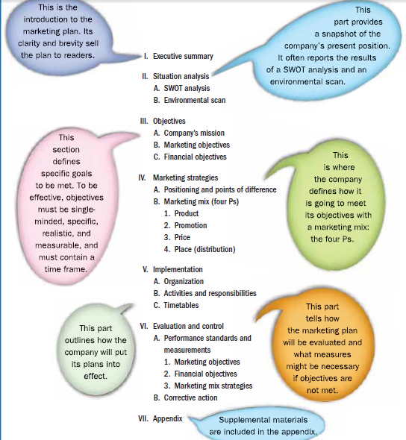

Slide 15
Evaluation
Conclusion
  Continuous evaluation of the three phases of the marketing process
    Planning, implementation, and control
  Key question:
    Did we accomplish the objectives listed in the marketing plan within the boundaries of the plan
  Marketing audit evaluates a company’s marketing objectives, strategies, budgets, organization, and performance
    Identifies problem areas in marketing operations
      Usually conducted once a year, but informally on a continuous basis

Slide 16
Review – to Hand in!
What is a SWOT analysis and why is it helpful?
How can a business use a SWOT analysis and an environmental scan to create a marketing plan?
Why are evaluation and control important elements of a marketing plan?
How can a country’s current economic situation impact a business’s marketing plan?

Slide 17
Review- Application
If a company’s current sales revenue is $1,386,000 and its marketing objective is to increase sales by 10 percent in the next year, what is the dollar sales goal for the following year?

Slide 18
Market Segmentation

Slide 19

Identifying and Analyzing Markets
Look for ways to connect with current and potential customers
  Get to know them well
    Where do they live?
    What is their income?
    Age?
    Ethnic background?
    Activities?
    Values?
    Interests?
      What do they all have in common?

Slide 20

Market Segmentation
The process of classifying people who form a given market into even smaller groups
Example: Market for Jeans
  Who? Price? Special Features?
    Age: kids, teens, adults
    Price: Different income levels (socio-economic groups)
    Desired features: tight fit, comfortable fit, newest fashion, unique design
  Depending on answers, manufacturing will develop a unique marketing mix
    Which of these segments should we target?
      Costly to target all

Slide 21

Market Segmentation Continued…
Identify the markets to which you have an advantage over the competition
  Sustainable competitive advantage
Companies study data generated by:
  Governments, private research firms, trade associations, and own research
    Examples: census data (age groups)
    CREATE A CUSTOMER PROFILE
      The more specific, the easier it is to get the right product in the intended customer

Slide 22
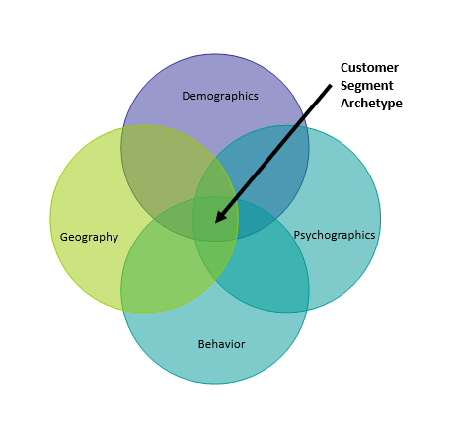

Slide 23

Demographics
Statistics that describe a population in terms of personal characteristics
  Age, gender, income, marital status, ethnic background, education, occupation
Segment by Age
  Example: Segment by generation
    Baby boom generation (1946 and 1964)
      Getting older can have 2 effects
    Generation X (Baby Bust)
      Followed by baby boom generation
      Children of dual-career or divorced parents
      Savvy yet skeptical consumers - Due to media exposure, marketers should use images, sounds, humor, etc.
    Generation Y (Echo boomers or Millennium Generation)
      Sons and daughters of the later baby boomers
      More racially and ethnically divers and more spending power – tech users

Slide 24
Demographics Continued…
Segment by Gender
  Example: Jockey
Segment by Income
  2 types of income measurement:
    Disposable income
      Money left over after taking out taxes
        ***Marketers who produce and distribute necessity items
    Discretionary income
      Money left after paying for basic living necessities
        Food, shelter, clothing
          ***Marketers who sell luxury and premium products

Slide 25
Demographics Continued…
Segment by Marital Status
  U.S. Census: 50.7% of total households are married (80% in 1950)
  Married couples with kids represent 25% of the population
Segment by Ethnicity
  Increase in population partly due to immigration
  More diverse than ever before

Slide 26
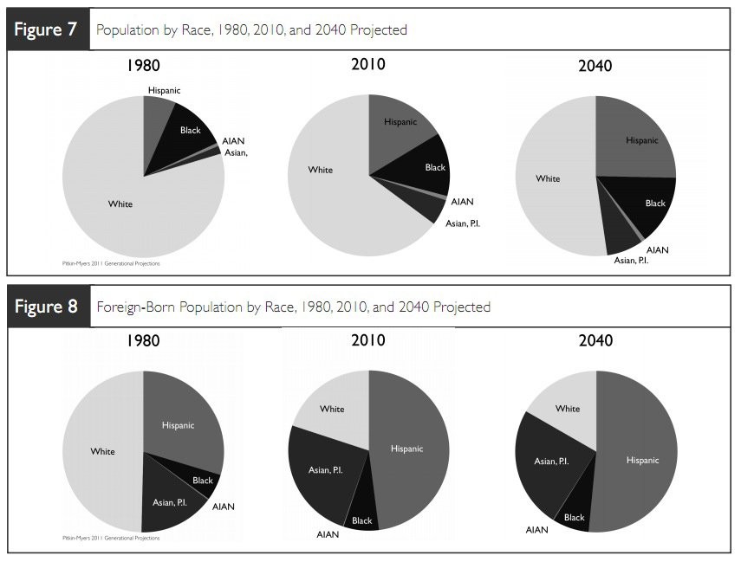
Why is it important to know this?

Slide 27

Geographics
Segmentation of the market based on where people live
  Closely related to demographics due to similarities among people within an area
  Segment:
    Local, regional, national, or global
      Examples: restaurant in town vs. Pepsi

Slide 28
Geographics Continued….
Examples
  Marketing to Latinos
    Know the top Hispanic Markets: LA, NY, Miami, Chicago, Houston
      Introduce a new line of Hispanic products, best place to market test them would be in these geographic regions
  55% of the African American population lives in the south
    However, largest populated cities are NY, Chicago, Detroit, Philadelphia, Houston, LA, Baltimore, Memphis, and Washington DC
      Market to African Americans, best to distribute to these areas

Slide 29
Geographics Continued….
Examples:
  Children
    Utah and Alaska had the highest proportion (15%)
    Texas, Arizona, California, and Idaho (14%)
  2003 – 65+ years old
    California (3.8 million), Florida (2.9 million), NY (2.5 million), Texas (2.2 million), PA (1.9 million)
  2002 – median household Income of $55,000 or less
    Maryland, Alaska, Minnesota, New Hampshire, Connecticut, New Jersey, Delaware, Massachusetts
      Banks/financial institutions have interest as these are more likely to invest and hold insurance
      Makers of luxury items would also target these areas

Slide 30
Psychographics
Grouping people with similar lifestyles, attitudes, values, and/or opinions
  How do they spend their time and money?
  What are their personality traits and motivation?
Activities
  Write down as many activities that you are involved in
  Look at magazines in stores – these will help identify the many activities people are involved in
    Each of these are market segments

Slide 31
Psychographics
Attitudes
  Taking responsibility for one’s health
    Eating healthier, becoming physically fit
      All trend setting issues for marketers
Personality & Values
  Personality characteristics and values
    Big 5 Activity
    Personal Values Assessment

Slide 32
Behavioral
Looking at the benefits desired by consumers, shopping patterns and usage rate
  Regardless of socio-economic status, luxury/premium items are desired by all
How do marketers use consumers’ behavioral patterns? Online Buyer Behavior Research
  Shopping patterns – usage rates
    Most teenagers spend less than $50 a month on entertainment – girls spend 15% more on music than boys
  Classify according to the percentage of sales each group generates
    80/20 rule – 80% of a company’s sales are generated by 20% of its loyal customers

Slide 33
Mass Marketing vs Segmentation
Mass Marketing
  Using a single marketing strategy to reach all customers
    Used when few features differentiate them from competitors
    Usually through media: TV, radio, newspapers
      Examples: Necessities – Toothpaste
    Not used as much as once before as much can be segmented
  Opposite of Niche Market
    Specific Segmenting
      Example: YES Network
  Got Milk? Was once mass marketed, but now can be niched
    Purpose?

Slide 34
Review
Which type of income is more important to business that sell expensive watches, second homes, and financial services?
Of what significance are the combined African American, Hispanic, and Asian-American populations to marketers?
A recent study shows that teems are drinking more bottled water and reducing the amount of carbonated beverages they drink. Which psychographic or lifestyle trend does this study support?

Slide 35
Review Continued….
If 93 percent of the U.S. population (Approx. 300 million) snacks at least once a day, how large is the market for snack food?
Why do you think the US conducts a census of its residents every 10 years?
  Do you think it should be more or less often?

Slide 36
Outline
Marketing Plan in Detail
Executive Summary
Situation Analysis
  SWOT Analysis
  Environmental Scan
Goals and Objective
  Company’s Mission
  Marketing Objectives
  Financial Objectives
Marketing Strategies
  Positioning and points of difference
  Marketing mix
Implementation
  Organization
  Activities
  Timetables
Situation Analysis
  SWOT
  (PEST as an external driver)
Internal
Strength Weakness
External
Opportunities and Threats
Notes:
After Test review and preparation for project

Slide 37
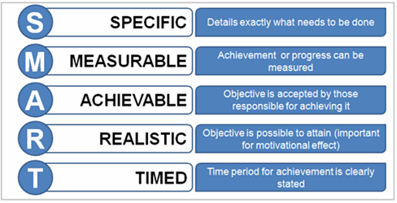
Outline
Marketing Plan in Detail
Executive Summary
Situation Analysis
  SWOT Analysis
  Environmental Scan
Goals and Objective
  Company’s Mission
  Marketing Objectives
  Financial Objectives
Marketing Strategies
  Positioning and points of difference
  Marketing mix
Implementation
  Organization
  Activities
  Timetables
Goals and Objectives
(Will return to Mission statement)
  Marketing Objectives
  Financial Objectives
Notes:
After Test review and preparation for project

Slide 38
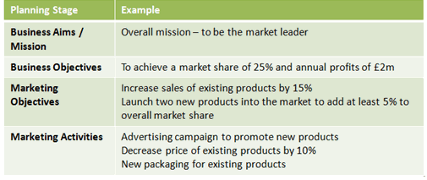
Outline
Marketing Plan in Detail
Executive Summary
Situation Analysis
  SWOT Analysis
  Environmental Scan
Goals and Objective
  Company’s Mission
  Marketing Objectives
  Financial Objectives
Marketing Strategies
  Positioning and points of difference
  Marketing mix
Implementation
  Organization
  Activities
  Timetables
Marketing Strategies
  Positioning and Points of Difference
Marketing Mix
  The marketing mix can help create points of difference
Notes:
After Test review and preparation for project

Slide 39
Outline
Marketing Plan in Detail
Executive Summary
Situation Analysis
  SWOT Analysis
  Environmental Scan
Goals and Objective
  Company’s Mission
  Marketing Objectives
  Financial Objectives
Marketing Strategies
  Positioning and points of difference
  Marketing mix
Implementation
  Organization
  Activities
  Timetables
Implementation
  Organization
    Financial resources, management, and staffing
  Activities
    Job Assignments
    Sales forecasts
    Budgets
    Details of each activity
  Timetable
    What will be introduced when and when it is expected that it will be completed
Notes:
After Test review and preparation for project

