Slide 1
Fluid Power Systems
PoE

Slide 2
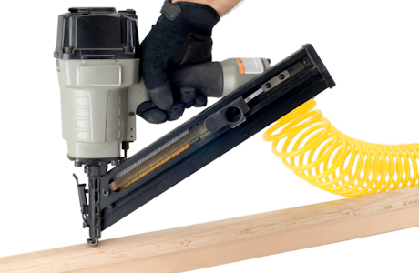
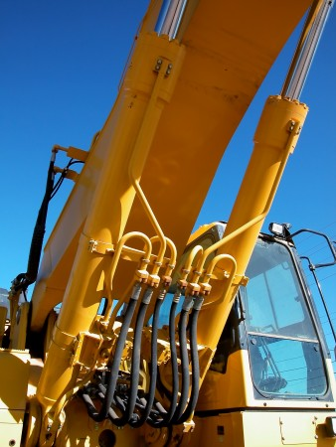
Fluid Power
the use of a confined fluid flowing under pressure to transmit power from one location to another.
Gases -> Pneumatics
Liquids -> Hydraulics

Slide 3
Basic Principles of Fluid Power
Area
$$A_{circle}= \frac{πd^{2}}{4}= πr^{2}$$

Slide 4
Basic Principles of Fluid Power
Force - is a push or pull that acts on an object, causing that object to move, change its motion, or deform in some way.
$$F=mass ×acceleration$$
Units:
1 N = 0.225${lb}_{f}$

Slide 5
Basic Principles of Fluid Power
Pressure -a type of load that occurs when a force is distributed across an area and acts perpendicular to the surface.
$$pressure=\frac{Force}{Area}$$
Units:
US customary units -> $\frac{lb}{{inch}^{2}}$ or PSI
Metric units -> 1 Pascal (Pa) = $1\frac{N}{m^{2}}$
Standard Pressure :
1 atm = 1.01325 bar
= 33.9 ft H2O
= 29.92 in. Hg
= 760 mm Hg
= 101,325 Pa
= 14.7 psi

Slide 6
Blaise Pascal
He lived during
the 17th century.
In 1647, Pascal
published what is
known today as
Pascal’s law.
It states that pressure exerted on a confined fluid is transmitted equally and perpendicular to all of the interior surfaces of the fluid’s container

Slide 7
Pascal’s Law
The pressure within the fluid in cylinder A ($p_{i}$) must be equal to the pressure within cylinder B ($p_{o}$)
$p_{i}= p_{o}$
$\frac{F_{i}}{A_{i}}= \frac{F_{o}}{A_{o}}$

Slide 8
Pascal’s Law
What is the output force?

Slide 9
Hydraulic Amplification of Force
What is the output force?

Slide 10
Hydraulic Amplification of Force
$\frac{Output Force}{Input Force}= \frac{distance moved by output force}{distance moved by input force}$
$∆V_{i}= ∆V_{o}$
$A_{i}h_{i}= A_{o}h_{o}$

Slide 11
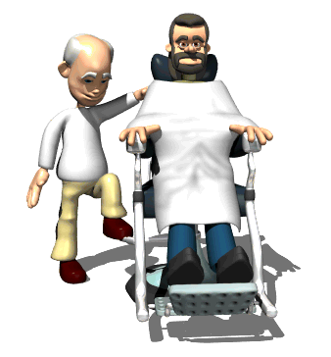
A barber raises his customer’s chair by applying a force of 150N to a hydraulic piston of area 0.01 m². If the chair is attached to a piston of area 0.1 m², how massive a customer can the chair raise? Assume the chair itself has a mass of 5 kg.

Slide 12
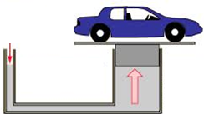
A hydraulic system is used to lift a 2000-kg vehicle in an auto garage. If the vehicle sits on a piston of area 0.5 square meter, and a force is applied to a piston of area 0.03 square meters, what is the minimum force that must be applied to lift the vehicle?

